Slide 1
Fridge Fresh
By: Creighton Laub, Lauren Evans, Ted Dayton, Charlie Higgins, and Alexx hoerl

Slide 2
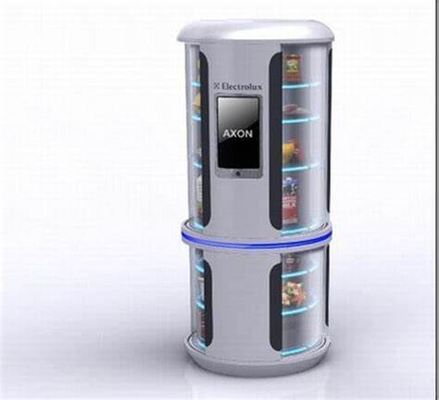
The Fridge Fresh Prototype

Slide 4
Narrow AI

Slide 5
Influencers

Slide 6
Partnerships

